Slide 1



Cover Page
Monday, 29 Sep 2025
PROJ703/ PROJ903 International Challenge Project “Eurocup”
By Group-04
Ref:01
Reff:01= https://www.coupederobotique.fr/edition-2026/reglement-2026/
Page-01

Slide 2
Table of Content
Team Introduction - 03
Road Map -04
Team Chatter –05
Management-06
Page - 02

Slide 3
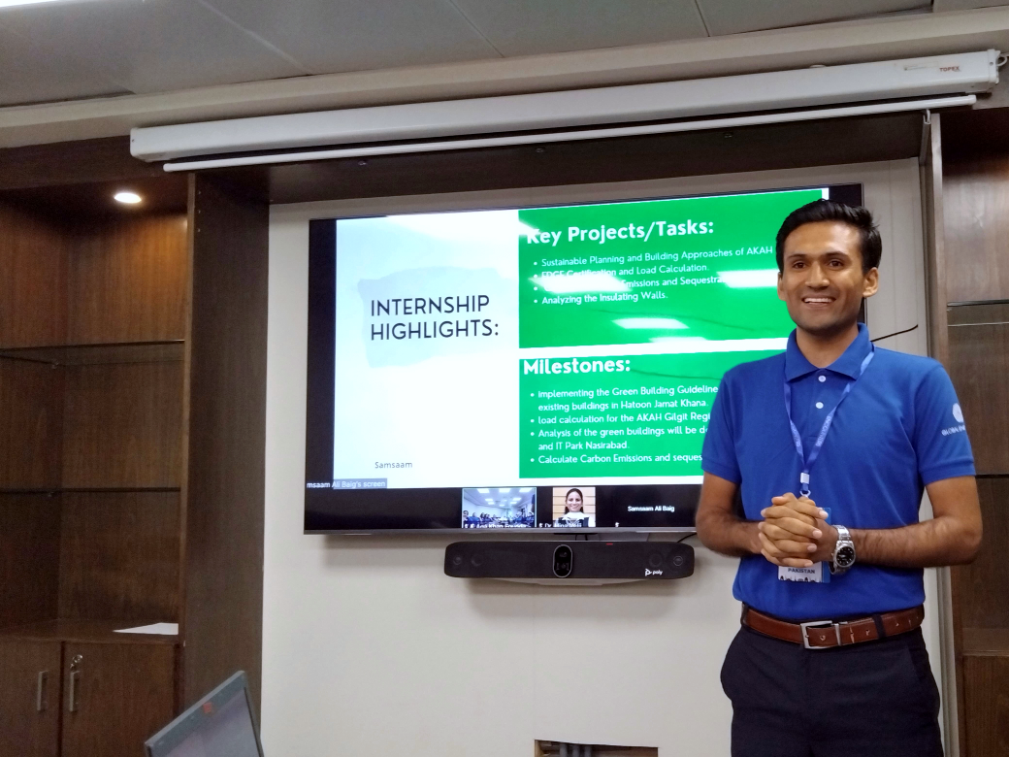
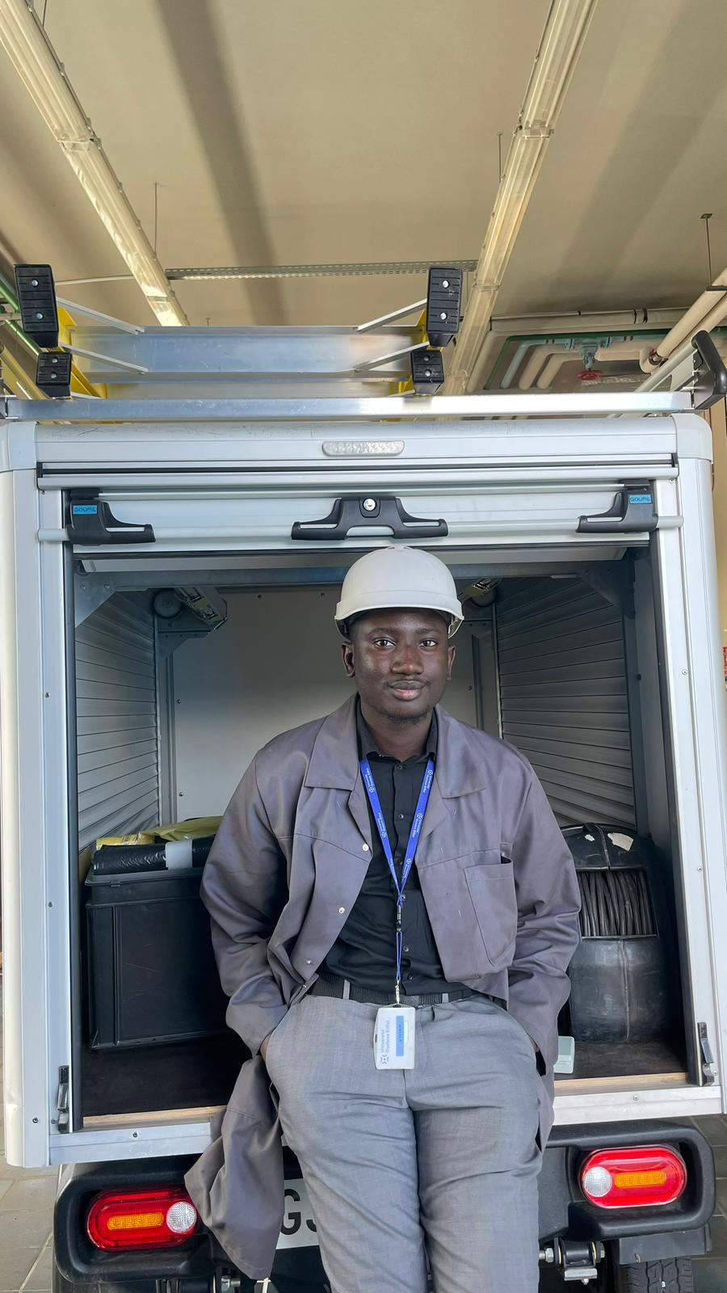
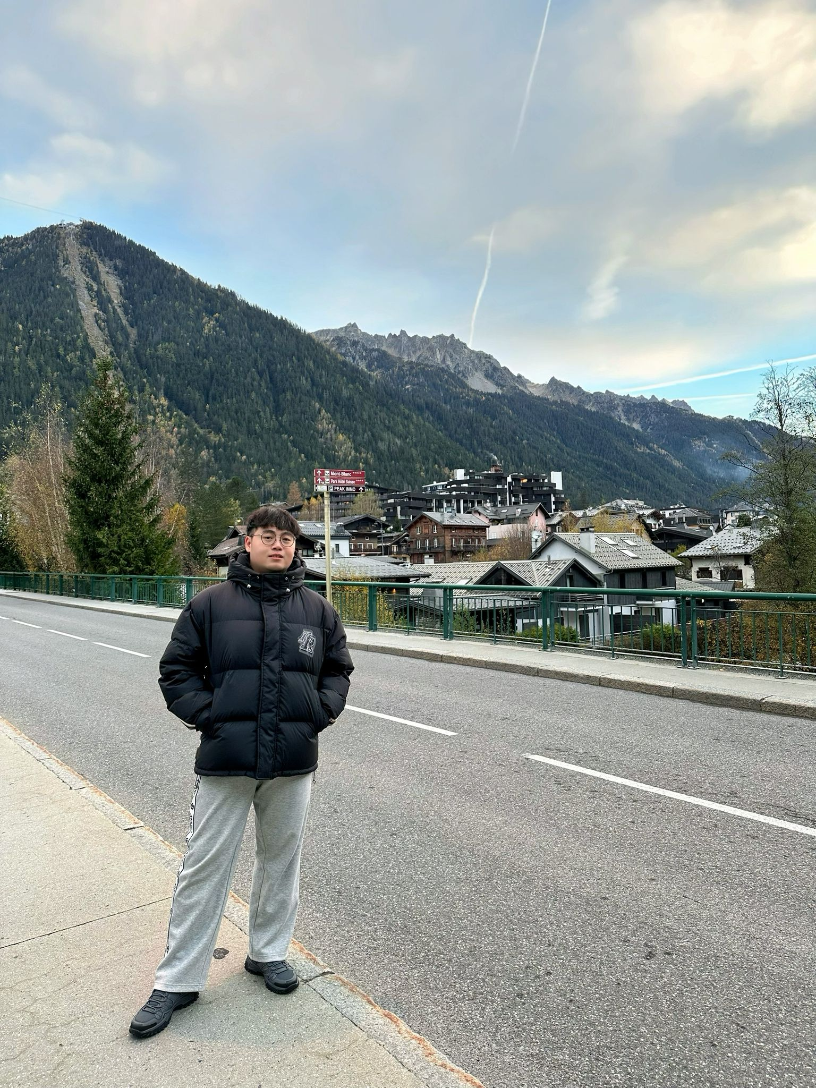
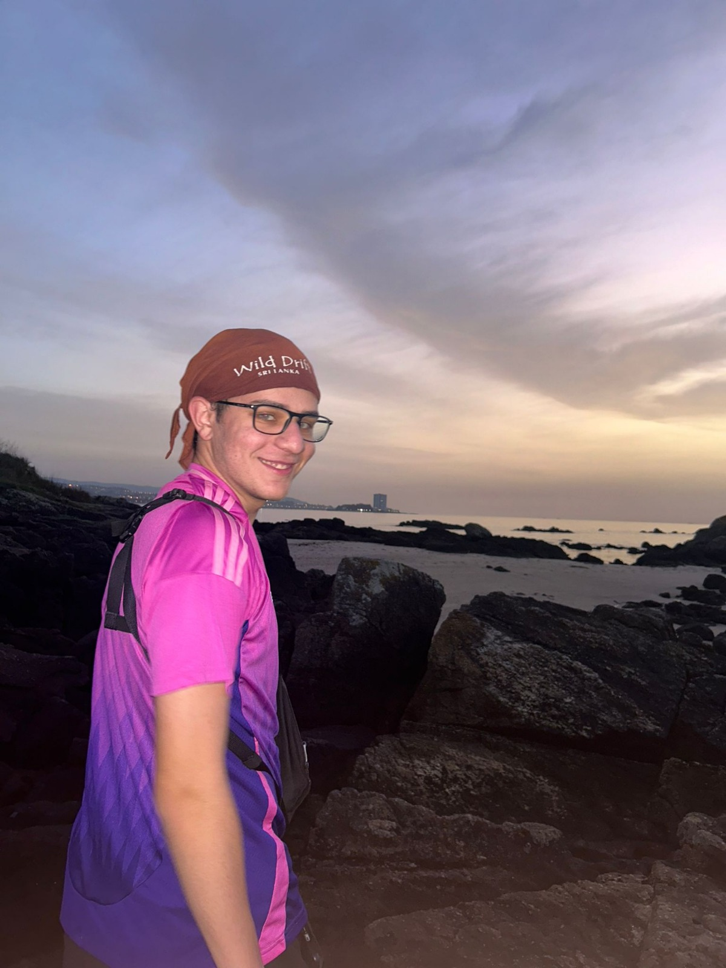
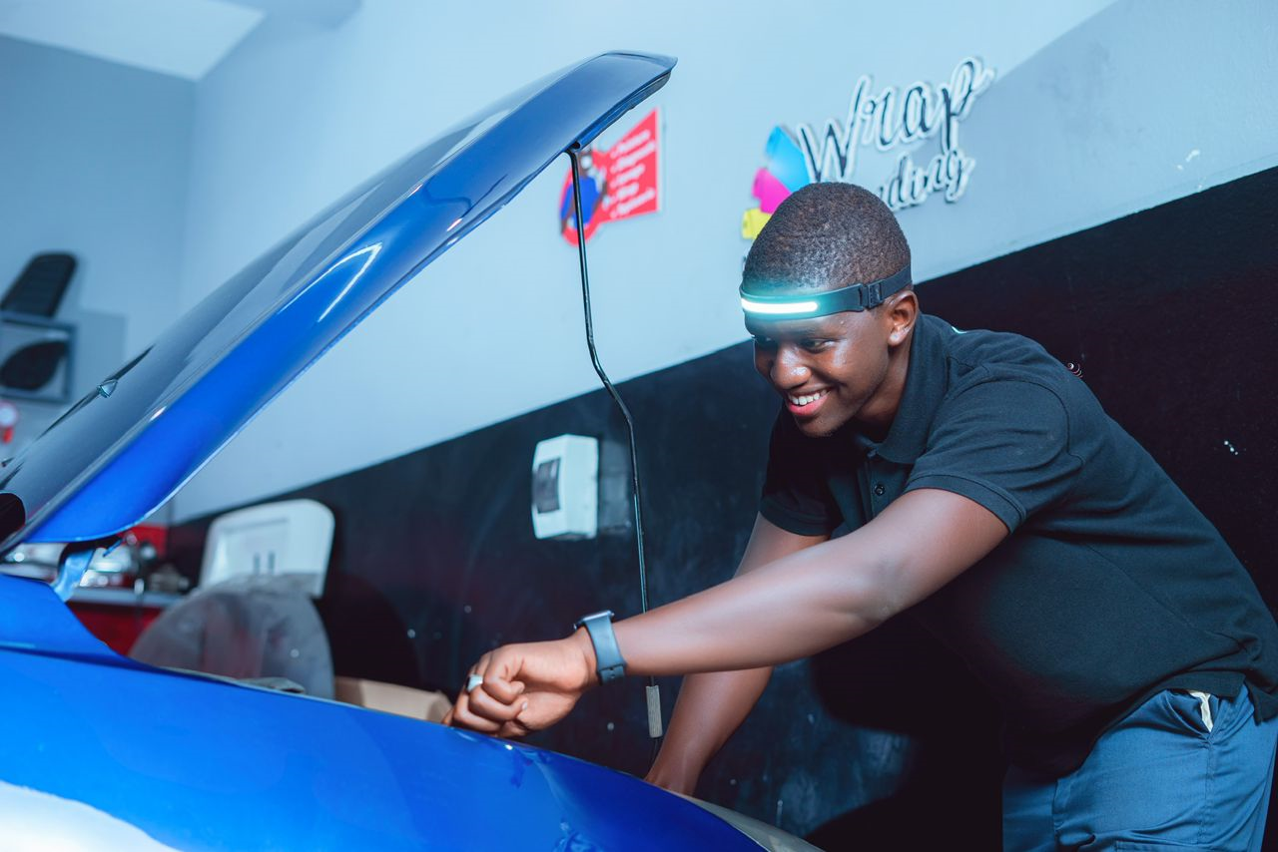
THE TEAM & OUR COMPETENCIES
Samsaam Ali Baig
Mechanical Engineering
Sidy Thiaw
Electromechanical Engineering
Qiao Zhonghe
Mechanical Design, Manufacturing & Automation
Zad ABOU JAOUDE
Electrical Engineering
Papa Madiarra-Sene
Mechatronics Engineering
Page - 03

Slide 4
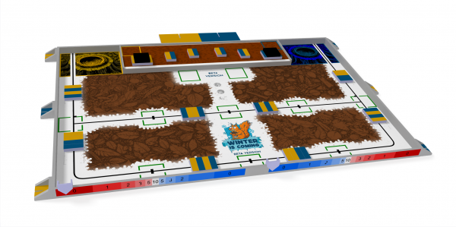
1- Learn and understand the game rules. 2- Creating a plan that incorporates a timeline and strategy. 3- Assigning roles & tasks (both technical & non-technical). 4- Follow the plan created in step 2. 5- Regularly update team members, professors and the plan.
ROADMAP
Page - 04

Slide 5
Be punctual. Respect deadlines Be responsible and honest Communicate clearly Keep motivation high Be flexible and adaptive Be curious and respectful of others
TEAM CHARTER & GENERAL GUIDELINES
Page - 05

Slide 6


Management
1.Weekly meeting
2.Frequent online communication
3.Using Probant and Teams
Stage 1：It is necessary to understand the objectives and rules of the project.
Stage 2： Plan our project, including task allocation and time management，etc.
Stage 3：Execution and Task Tracking
Stage 4：Test and conclude the project
Page - 06

